Slide 1





















Miscellaneous
Angelo Ziletti, PhD
Principal Data Scientist, Bayer AG

Slide 2
Lecture Outline
Part 1.
Structural representations for physical systems
1
Part 2.
Interpreting ML models with SHAP
2
Part 3.
AI Feynman
3
Part 4.
ML limitations
4

Slide 3
Representation is key
The difficulty of a given task is often highly dependent on how the task is given to us
Example: integer division
CLIX / III = ? (Latin numbers, not a convenient representation for us)
159/3 = ?
Even easier with long divisions
Many information processing tasks can be very easy or very difficult depending on how the information is represented
This is also true for machine learning tasks
Feature space: where the machine learning starts

Slide 4
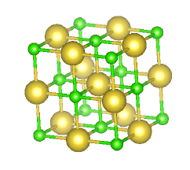


Representing the input in a meaningful way is key for ML
(Raw) Input of modelling
Feature space
(or embedding space)
Natural language processing
“Can I take the medicine before a long-haul flight?”
Representation
Convert text to a vector in meaningful way (e.g. capturing the text meaning)
Data-driven modelling of molecules and materials
Representation
Convert the 3D dimensional structure to a vector in a meaningful way (e.g. symmetries)

Slide 5
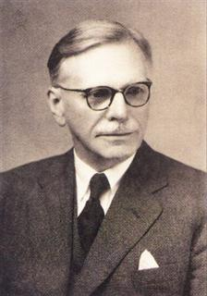




Representing words by their context
“You shall know a word by the company it keeps” (J. R. Firth 1957)
A word’s meaning is given by the words that frequently appear close-by
Distributional semantics: one of the most successful ideas of modern statistical natural language processing (NLP)
…26m11s is the world record for the 10,000 for men…
…oh no, I deleted the record from the production database …
…did you record the meeting?
These context words will represent record
How do we learn the semantic of words?
Context independent: word2vec models (Mikolov et al. 2013, Google)
Context dependent: BERT-like models (Devlin et al. 2018, Google)

Slide 6
We can learn a lot reconstructing the input!
Stanford University is located in __________, California. [Trivia]
The woman walked across the street, checking for traffic over ____ shoulder. [coreference]
I went to the ocean to see the fish, turtles, seals, and _______. [lexical semantics/topic]
Overall, the value I got from the two hours watching it was the sum total of the popcorn and the drink. The movie was _______. [sentiment]
No labels required: huge amount of data available to train the model on (~Billion of words)
Complex neural networks are able to learn syntax, word meaning,… directly from data
Huge computational effort (~10s-100s GPU/days)
… but the resulting models are available for free! → Pretrained language models
BERT (Devlin et al., https://arxiv.org/abs/1810.04805 Google, 2018) - this model is used by Google in Google Search
Examples from http://web.stanford.edu/class/cs224n/slides/cs224n-2021-lecture10-pretraining.pdf

Slide 7
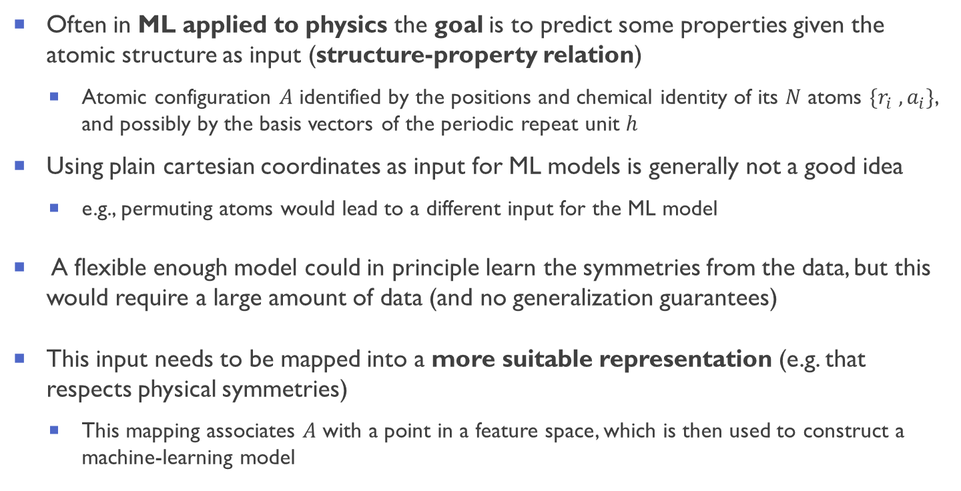
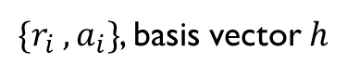
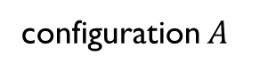
The need for a representation
Often in ML applied to physics the goal is to predict some properties given the atomic structure as input (structure-property relation)
Atomic configuration $A$ identified by the positions and chemical identity of its $N$ atoms $\{r_{i} ,a_{i}\}$, and possibly by the basis vectors of the periodic repeat unit $h$
Using plain cartesian coordinates as input for ML models is generally not a good idea
e.g., permuting atoms would lead to a different input for the ML model
A flexible enough model could in principle learn the symmetries from the data, but this would require a large amount of data (and no generalization guarantees)
This input needs to be mapped into a more suitable representation (e.g. that respects physical symmetries)
This mapping associates $A$ with a point in a feature space, which is then used to construct a machine-learning model
configuration $A$
$\{r_{i} ,a_{i}\}$, basis vector $h$
Representation
ML Modeling
Desired Property, class

Slide 8
Why a good representation is useful for ML in physics?
Models based on physically-inspired representations tend to perform better
“Over the past few years, it has become clear that representations that reflect more closely some fundamental principles such as locality, the multiscale nature of interactions, and the similarities in the behavior of elements from the same group in the periodic table usually yield models that are more robust, transferable, and data-efficient” [1]
Underspecification is a key (open) problem in machine learning [2]
“A ML pipeline is underspecified when it can return many predictors with equivalently strong held-out performance in the training domain.” [2]
ML models based on (good) physical representations introduce some meaningful inductive biases
The representation introduces an implicit regularization that incorporate domain expertise (physics knowledge) without compromising the prediction abilities of ML models
[1] Musil et al., Physics-Inspired Structural Representations for Molecules and Materials. Chem Rev. (2021)
[2] D’Amour et al., arXiv:2011.03395 (2020)

Slide 9
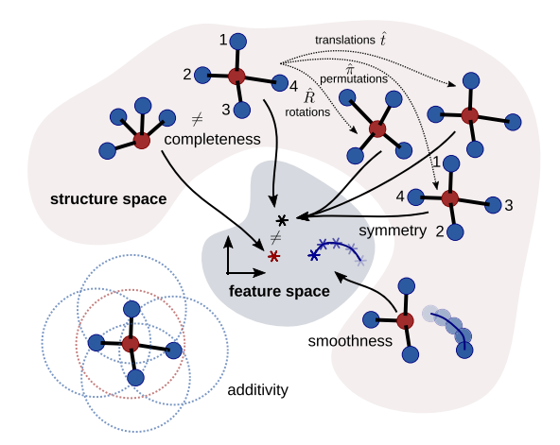
Basic requirements for effective structural representations
The mapping between structures and feature space should [*]
obey fundamental physical symmetries
equivalent structures should be mapped to the same features
be complete
inequivalent structures should be mapped to distinct features)
be smooth
continuous deformations of a structure should map to a smooth deformation of the associated features
be additive:
a structure should be decomposed in a sum of local environments (usually atom-centered), ensuring transferability and extensivity of predictions
Figure from [*]
[*] Musil et al., Physics-Inspired Structural Representations for Molecules and Materials. Chem Rev. (2021)

Slide 10
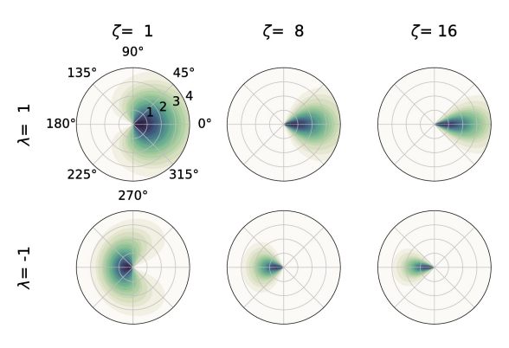
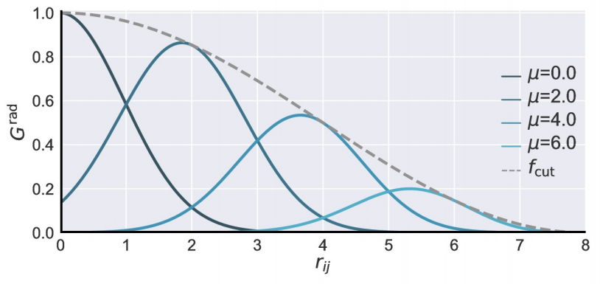
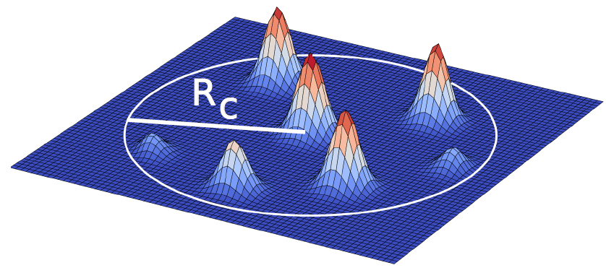
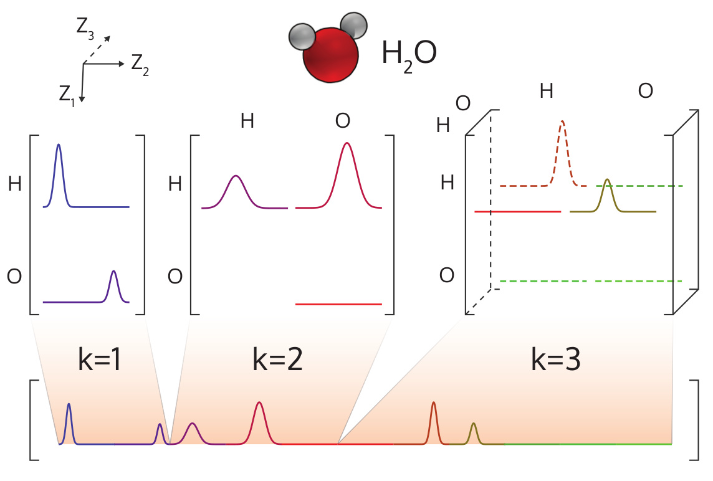
Examples of physics-based representations
Atom-centered symmetry functions (ACSF)
Behler and Parrinello, Phy. Rev. Lett. 98 (14), 146401 (2007)
Behler, J. Chem. Phys., 134(7):074106 (2011)
Smooth overlap of atomic positions (SOAP)
P. Bartók et al., Phys. Rev. B 87, 184115 (2013)
Many-body tensor representation (MBTR)
Huo and Rupp, arXiv:1704.06439 13754 (2017)

Slide 11
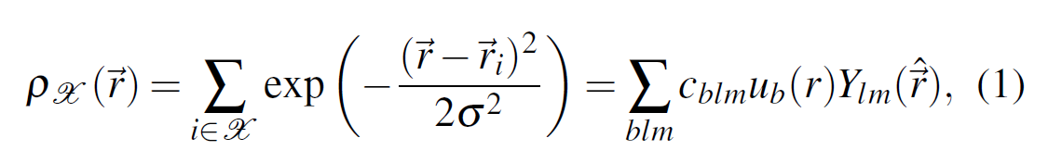
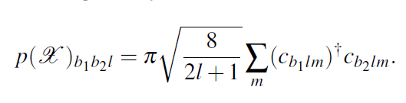
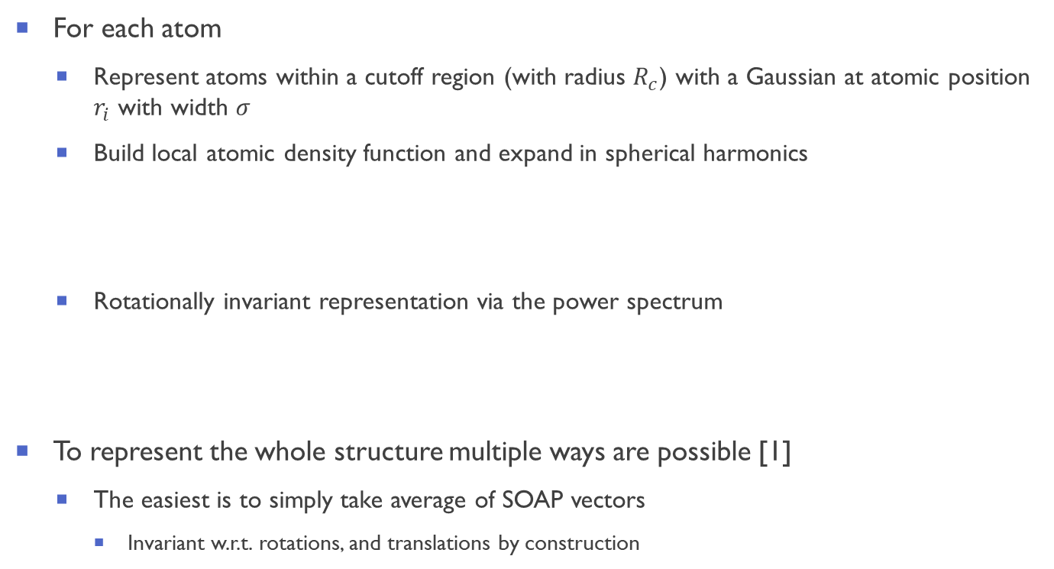

Smooth overlap of atomic positions SOAP
For each atom
Represent atoms within a cutoff region (with radius $R_{c}$) with a Gaussian at atomic position $r_{i}$ with width $σ$
Build local atomic density function and expand in spherical harmonics
Rotationally invariant representation via the power spectrum
To represent the whole structure multiple ways are possible [1]
The easiest is to simply take average of SOAP vectors
Invariant w.r.t. rotations, and translations by construction
[1] SOAP: A. P. Bartók et al., Phys. Rev. B 87, 184115 (2013) [2] SOAP (picture): A. P. Bartók and G. Csányi, Int. J. Quantum Chem. 115, 1051-1057 (2015)

Slide 12
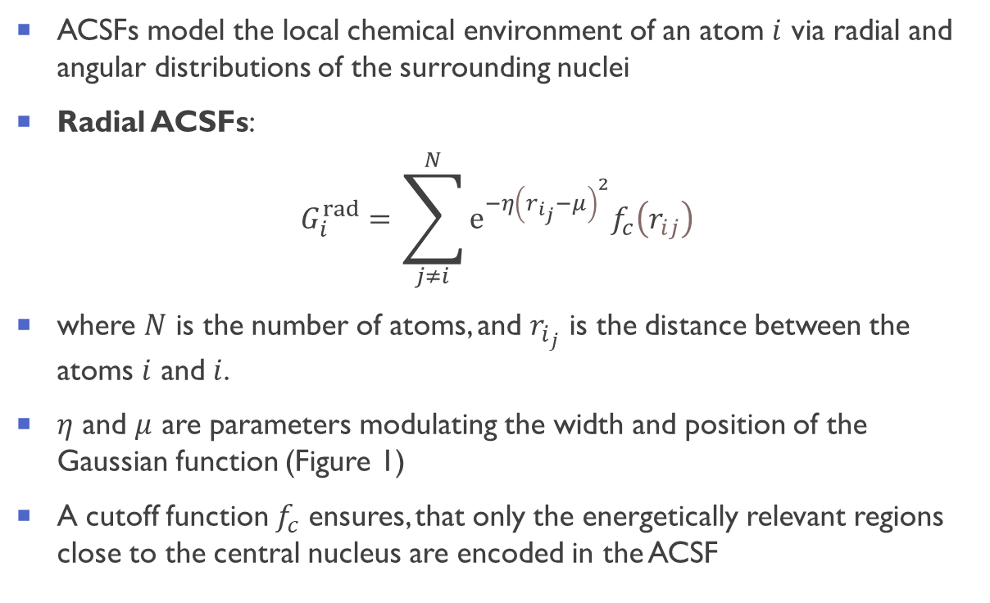
Atom-centered symmetry functions (ACSF): radial part
ACSFs model the local chemical environment of an atom $i$ via radial and angular distributions of the surrounding nuclei
Radial ACSFs:
$$G_{i}^{rad}=\sum_{j≠i}^{N}{ⅇ^{−η{\left(r_{i_{j}}−μ\right)}^{2}}f_{c}\left(r_{ij}\right)}$$
where $N$ is the number of atoms, and $r_{i_{j}}$ is the distance between the atoms $i$ and $i$.
$η$ and $μ$ are parameters modulating the width and position of the Gaussian function (Figure 1)
A cutoff function $f_{c}$ ensures, that only the energetically relevant regions close to the central nucleus are encoded in the ACSF
[1] Behler and Parrinello, Phy. Rev. Lett. 98 (14), 146401 (2007) [2] Behler, J. Chem. Phys., 134(7):074106 (2011)
[3] Gastegger et al., J. Chem. Phys. 148 (24), 241709 (2018)
Notes:
The most widely used cutoff function in the context of ACSFs is defined as: fc(Rij ) = ( 1 2 h cos πrij rc + 1i , rij ≤ rc 0, rij > rc, (2) where rc is the cutoff radius specifying the size of the region surrounding the central atom (see Figure 1).

Slide 13

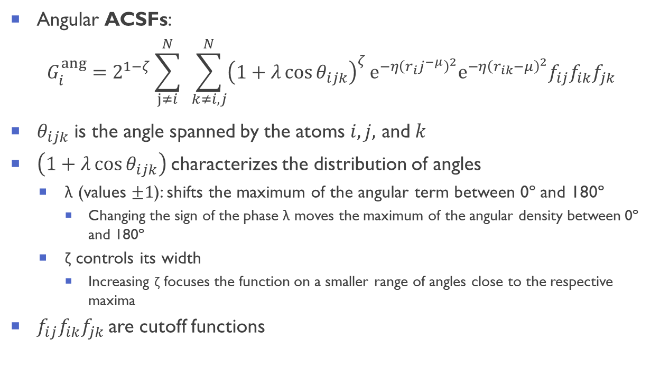

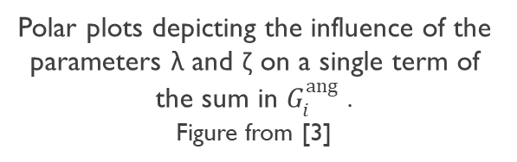
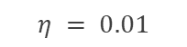
Atom-centered symmetry functions (ACSF): angular part
Angular ACSFs:
$$G_{i}^{ang}=2^{1−ζ}\sum_{j≠i}^{N}{ }\sum_{k≠i,j}^{N}{{\left(1+λ\cos{θ_{ijk}}\right)}^{ζ}}ⅇ^{−η{\left(r_{i}j^{−μ}\right)}^{2}}ⅇ^{−η{\left(r_{ik}−μ\right)}^{2}}f_{ij}f_{ik}f_{jk}$$
$θ_{ijk}$ is the angle spanned by the atoms $i,j,$ and $k$
$\left(1+λ\cos{θ_{ijk}}\right)$characterizes the distribution of angles
λ (values $±1$): shifts the maximum of the angular term between 0º and 180º
Changing the sign of the phase λ moves the maximum of the angular density between 0º and 180º
ζ controls its width
Increasing ζ focuses the function on a smaller range of angles close to the respective maxima
$f_{ij}f_{ik}f_{jk}$are cutoff functions
$$η = 0.01$$
Polar plots depicting the influence of the parameters λ and ζ on a single term of the sum in $G_{i}^{ang}$ .
Figure from [3]
[1] Behler and Parrinello, Phy. Rev. Lett. 98 (14), 146401 (2007) [2] Behler, J. Chem. Phys., 134(7):074106 (2011)
[3] Gastegger et al., J. Chem. Phys. 148 (24), 241709 (2018)
Notes:
. Although the top and bottom rows differ only in λ, a smaller spatial extent is observed for functions peaking at 180◦ compared to those with a maximum at 0◦ . This asymmetric behavior is due to the terms depending on rjk introduced in the angular descriptor.

Slide 14
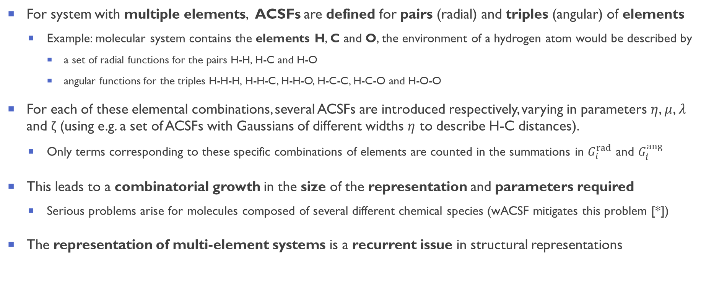
Treating multiple chemical species
For system with multiple elements, ACSFs are defined for pairs (radial) and triples (angular) of elements
Example: molecular system contains the elements H, C and O, the environment of a hydrogen atom would be described by
a set of radial functions for the pairs H-H, H-C and H-O
angular functions for the triples H-H-H, H-H-C, H-H-O, H-C-C, H-C-O and H-O-O
For each of these elemental combinations, several ACSFs are introduced respectively, varying in parameters $η$, $μ$, $λ$ and ζ (using e.g. a set of ACSFs with Gaussians of different widths $η$ to describe H-C distances).
Only terms corresponding to these specific combinations of elements are counted in the summations in $G_{i}^{rad}$ and $G_{i}^{ang}$
This leads to a combinatorial growth in the size of the representation and parameters required
Serious problems arise for molecules composed of several different chemical species (wACSF mitigates this problem [*])
The representation of multi-element systems is a recurrent issue in structural representations
[*] Gastegger et al., J. Chem. Phys. 148 (24), 241709 (2018)
Notes:
Finally, all these sets of radial and angular ACSFs are collected into a descriptor vector encoding the chemical environment of the central nucleus, based on which the elemental NNs make their predictions.

Slide 15


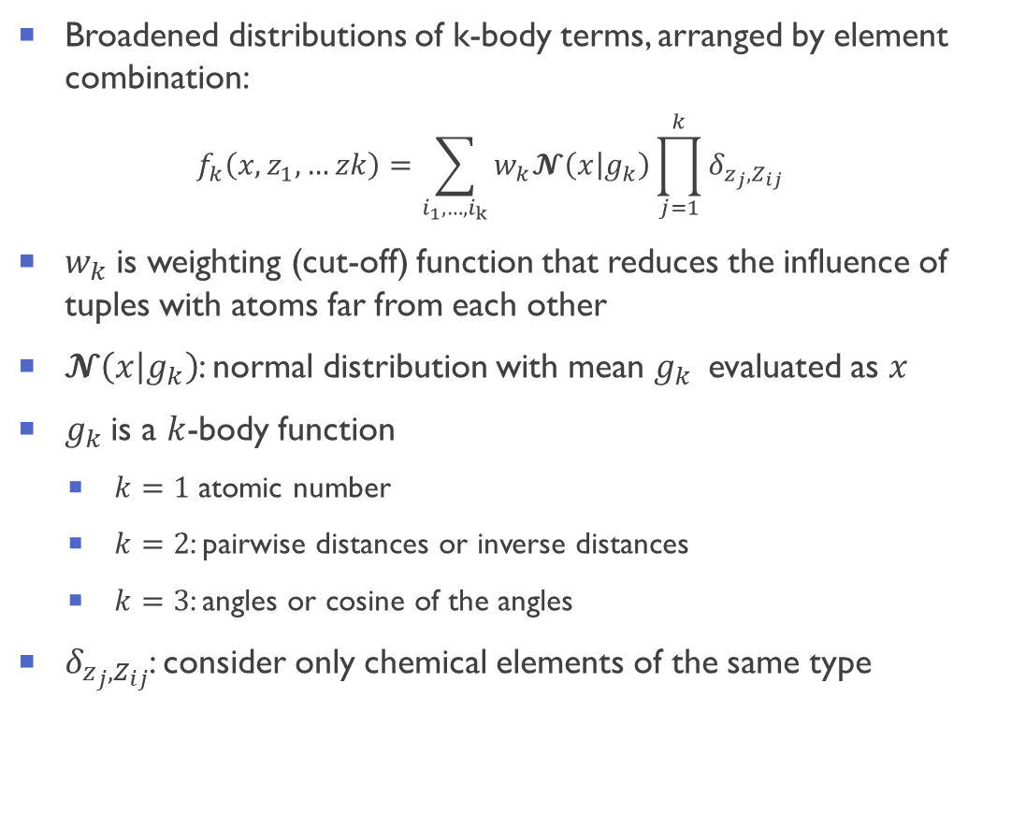

Many-body tensor representation (MBTR) [*]
Broadened distributions of k-body terms, arranged by element combination:
$$f_{k}\left(x,z_{1},…zk\right)=\sum_{i_{1},…,i_{k}}{w_{k}𝓝\left(\left.x\right|g_{k}\right)}\prod_{j=1}^{k}{δ_{z_{j},Z_{ij}}}$$
$w_{k}$ is weighting (cut-off) function that reduces the influence of tuples with atoms far from each other
$𝓝\left(\left.x\right|g_{k}\right)$: normal distribution with mean $g_{k}$ evaluated as $x$
$g_{k}$ is a $k$-body function
$k=1$ atomic number
$k=2$: pairwise distances or inverse distances
$k=3$: angles or cosine of the angles
$δ_{z_{j},Z_{ij}}$: consider only chemical elements of the same type
Figure from DScribe 1.1.x documentation
(Himanen et al Comput. Phys. Commun. 247, 106949 (2020))
[*] Huo and Rupp, arXiv:1704.06439 13754 (2017)
Notes:
[2] Langer et al., ArXiv: 2003.12081 (2020)

Slide 16
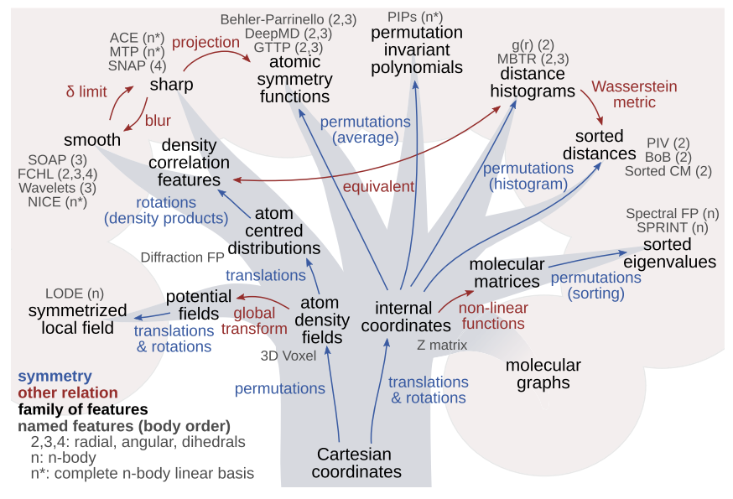
Many more structural representations are available
Wavelet scattering transform
Eickenberg et al., Solid Harmonic Wavelet Scattering, NIPS (2017)
Polynomial basis set:
Shapeev, Moment Tensor Potentials, Multiscale Model. Simul.14, 1153−1173.(2016)
Kajita et al., Universal 3D Voxel Descriptor for Solid-State Material Informatics […], Sci. Rep. 7, 16991 (2017)
Reciprocal-space representation for crystals (diffraction fingerprint)
Ziletti et al., Insightful classification of crystal structures using deep learning, Nature Comm 9(1) (2018)
Isayev, O. et al. Universal fragment descriptors for predicting properties of inorganic crystals. Nat. Commun. 8, 15679 (2017).
Figure from Musil et al., Physics-Inspired Structural Representations for Molecules and Materials. Chem Rev. (2021)

Slide 17
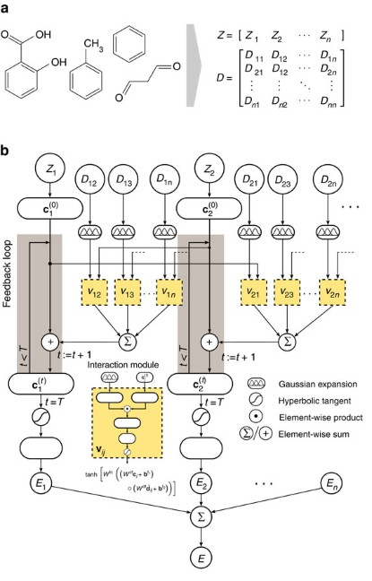
An alternative to physics-inspired structural representations
Physics-inspired structural representations are not the only way of representing molecules and crystals
A completely opposite philosophy is to encode the physical symmetries in the neural network architectures
Atomic coordinates and element types as input
Built-in physical constraint and symmetries via specialized neural network architectures
A couple of examples:
SchNet: Schütt. et al., Quantum-chemical insights from deep tensor neural networks Nat. Comm. 8 (13890) (2017)
Jørgensen et al., Neural message passing with edge updates for predicting properties of molecules and materials, arXiv:1806.03146 (2018)
… and in general all work based on neural message passing for quantum chemistry, Gilmer et al., ICML 70, 1263 (2017)
Figure from Schütt. et al., Nat. Comm. 8 (13890) (2017)

Slide 18
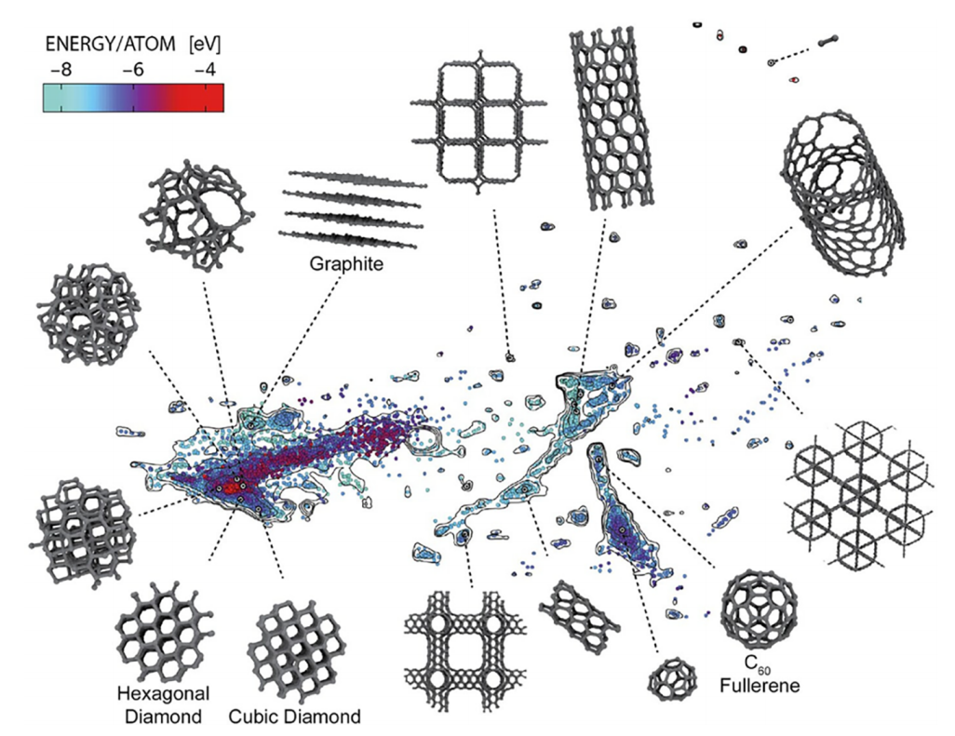
Application: build an accurate interatomic potential
Application: build an accurate interatomic potential using machine learning
Sketch-map describing the makeup of the structures included in the train set of an accurate and transferable potential for carbon
Selected structures are identified for graphite, diamond, hexagonal diamond (Lonsdaleite), amorphous carbon, and fullerenes
Points are colored according to their energy, while contours indicate the density of the database population in a particular region
[*] Rowe et al., An Accurate and Transferable Machine Learning Potential for Carbon J. Chem. Phys. 2020, 153, 034702

Slide 19

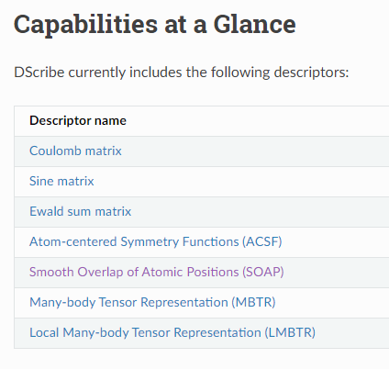
The Dscribe package
DScribe — DScribe 1.1.x documentation (singroup.github.io)
https://singroup.github.io/dscribe/latest
[1] Himanen et al., DScribe: Library of descriptors for machine learning in materials science, Comput. Phys. Commun. 247, 106949 (2020)

Slide 20
Interpretability in deep learning (and machine learning in general)
Deep learning models are generally hard to interpret due to their complexity (distributed knowledge across millions of parameters)
Despite that, there are methods that aim at interpreting neural networks
A great resource on machine learning interpretability: C. Molnar, Interpretable Machine Learning, https://christophm.github.io/interpretable-ml-book/ Ludwig Maximilian University of Munich
A review on neural network interpretability: Fan et al., ArXiv: 2001.02522 (2020)
We will briefly discuss one of the most successful interpretation method: SHAP [1]
SHAP unifies numerous available interpretation methods, including:
LIME: Ribeiro et al., SIGKDD International Conference on Knowledge Discovery and Data Mining (2016)
DeepLIFT: Shrikumar et al., arXiv preprint arXiv:1704.02685 (2017).
Layer-wise relevance propagation: Bach al., PloS one 10.7 (2015)
[1] Lundberg and Lee, NIPS 2017, ArXiv: 1705.07874

Slide 21
SHAP (SHapley Additive exPlanations)
SHAP (SHapley Additive exPlanations): a game theoretic approach to explain the output of any machine learning model. [1]
Main idea: Shapley value [2] calculate the importance of a feature by comparing what a model predicts with and without the feature
Coalition of players cooperates, and obtains a certain overall goal
Some players may contribute more to the coalition than others or may posses different bargain power
Shapley value answers the question: How important is each player to the overall cooperation, and what payoff can each play reasonable expect?
Machine learning application [1]:
Overall gain → prediction
Player importance → feature importance
[SHAP] [1] Lundberg and Lee, NIPS 2017, ArXiv: 1705.07874 [Shapley Value] [2] S. Shapley, Annals of Math. Studies, 28, 307 (1953)

Slide 22
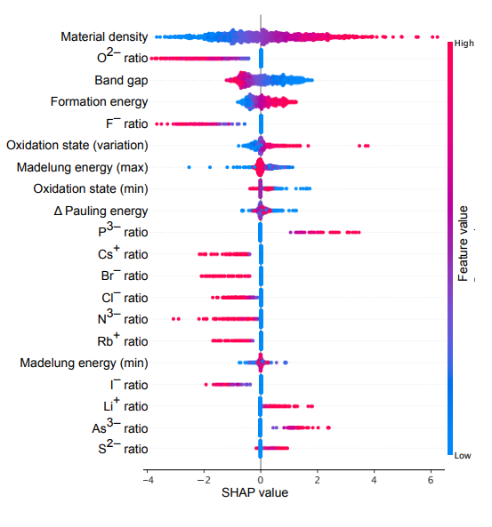



An example of SHAP in materials science [1]
Prediction of dielectric constants from physical features via Support Vector Regression and Deep Learning
Interpretation via SHAP of the predictions
Features ordered by their importance
A positive (negative) SHAP value indicates that a given feature contributes to an increase (decrease) in the prediction with respect to the mean of the set
Materials density: explained by both the Clausius-Mossotti and Penn expressions.
“If there are more electrons in a given volume, the dielectric response will become larger, and indeed SHAP analysis shows that dielectric constant monotonically increases with density”
Band gap: from the Penn model
“Lower energy excitations result a larger dielectric constant. A large band gap gives a negative SHAP contribution. ”
[1] Morita et al., Modelling the dielectric constants of crystals using machine learning, J. Chem. Phys. 153, 024503 (2020) ArXiv: 2005.0583

Slide 23
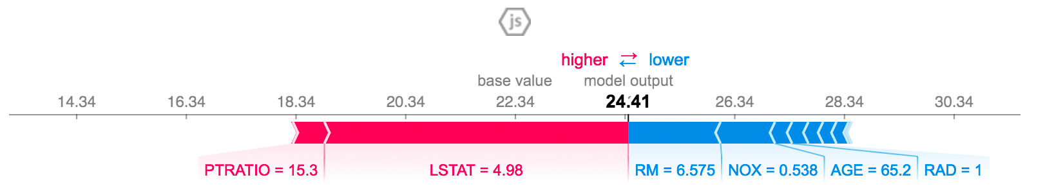
SHAP (SHapley Additive exPlanations)
One can also interpret single observations:
The above explanation shows features each contributing to push the model output from the base value to the model output (base value: the average model output over the training dataset)
Features pushing the prediction higher are shown in red, those pushing the prediction lower are in blue
A stable and reliable implementation of SHAP is available: https://github.com/slundberg/shap
[1] Lundberg and Lee, NIPS 2017, ArXiv: 1705.07874

Slide 24
Neural Networks for symbolic regression: AI-Feynman 2.0
Symbolic Regression: [1]
type of regression analysis that searches the space of mathematical expressions to find the model that best fits a given dataset, both in terms of accuracy and simplicity
No particular model is provided as a starting point to the algorithm
Initial expressions are formed by randomly combining mathematical building blocks such as mathematical operators, analytic functions, constants, and state variables.
Symbolic regression using neural networks: AI Feynman 2.0 [2]
Videotime: NeurIPS 2020 : AI Feynman 2.0: Pareto-optimal symbolic regression exploiting graph modularity
Seeks to fit data to formulas that are Pareto-optimal, in the sense of having the best accuracy for a given complexity
discovers generalized symmetries from gradient properties of a neural network fit
uses a fully-connected, feed-forward neural network with 4 hidden layers of 128, 128, 64 and 64 neurons, respectively
[1] From Wikipedia [2] Udrescu et al., NIPS 2020, ArXiv: 2006.10782 [2]

Slide 25
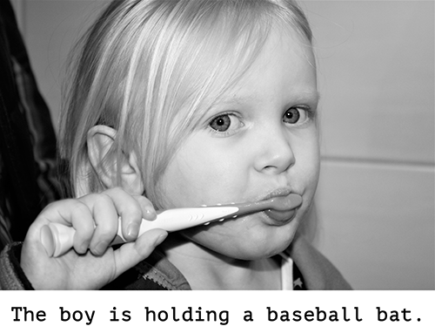
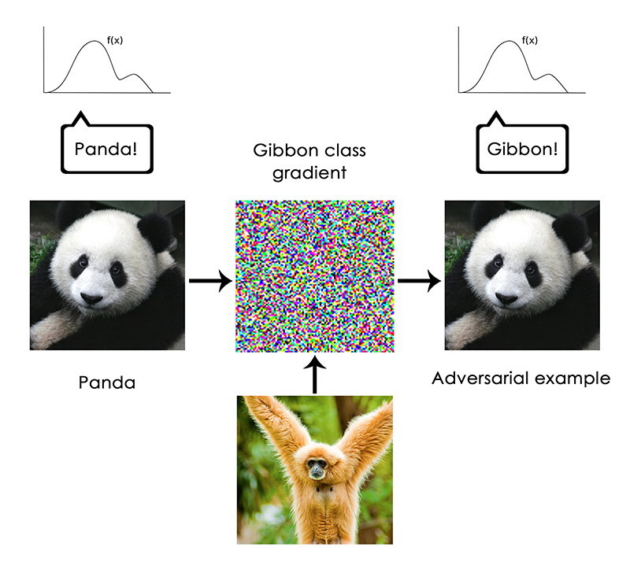
Deep Learning limitations [1]
“anything that requires reasoning […] is out of reach for deep learning models, no matter how much data you throw at them”
“a deep learning model is just a chain of simple, continuous geometric transformations mapping one vector space into another.
All it can do is map one data manifold X into another manifold Y, assuming the existence of a learnable continuous transform from X to Y, and the availability of a dense sampling of X:Y to use as training data”
“One very real risk with contemporary AI is that of misinterpreting what deep learning models do, and overestimating their abilities”
An adversarial example
[1] F. Chollet, (Keras developer and Google AI researcher): The limitations of deep learning (https://blog.keras.io/the-limitations-of-deep-learning.html)

Slide 26
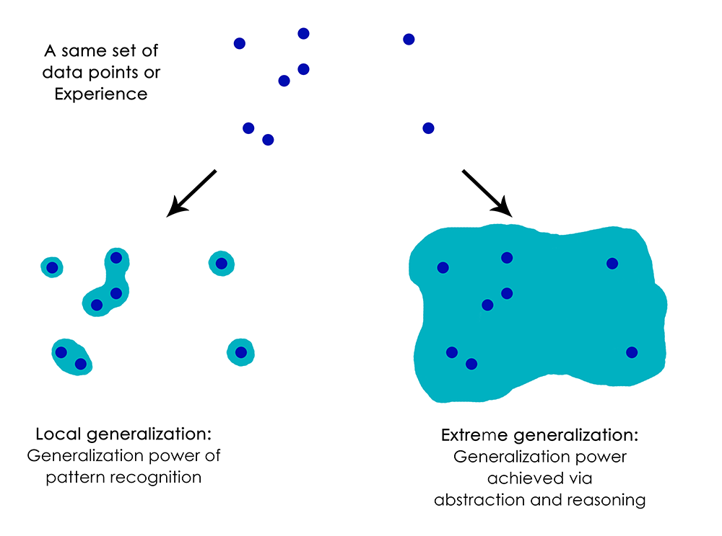
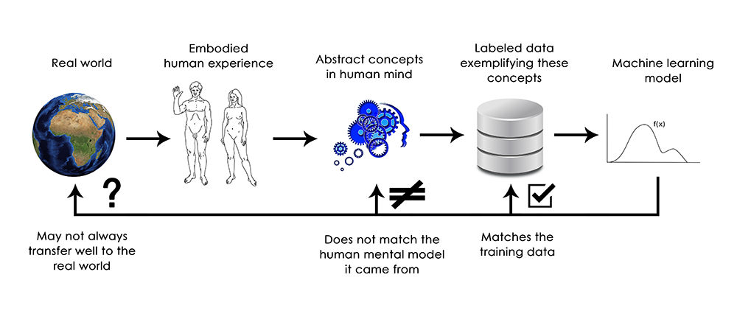
Deep Learning limitations [1]
“deep learning models do not have any understanding of their input, at least not in any human sense. Our own understanding of images, sounds, and language, is grounded in our sensorimotor experience as humans - as embodied earthly creatures. Machine learning models have no access to such experiences and thus cannot "understand" their inputs in any human-relatable way”
[1] F. Chollet, (Keras developer and Google AI researcher): The limitations of deep learning (https://blog.keras.io/the-limitations-of-deep-learning.html)

